Slide 1
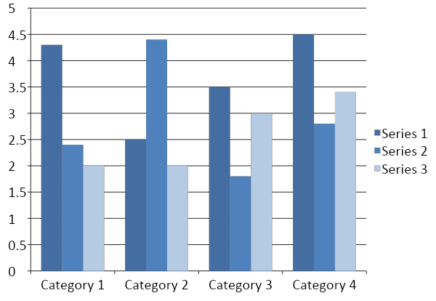
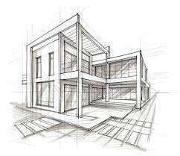
PROJECT TITLE
Names + Position
^{Institution / Affiliation}
Abstract: This study explores the integration of drone technology and AI for urban infrastructure inspection, focusing on improving efficiency and accuracy. We conducted empirical analysis and technical experiments to validate the system's performance. The findings demonstrate significant potential for enhancing urban monitoring and sustainability, contributing valuable insights to the Africa Smart and Sustainable Investment Summit.
Results / Findings (photos, …)
-
-
-
-
-
-
-
-
-
-
Introduction / Background
-
-
-
-
-
-
-
-
-
-
-
-
--
 | Heading | Heading | Heading
Item | 800 | 790 | 4001
Item | 356 | 856 | 290
Item | 228 | 134 | 238
Item | 954 | 875 | 976
Item | 324 | 325 | 301
Item | 199 | 137 | 186
Methods / Technology / Architecture / Materials (drawings, algorithm …)
Table 1. Label in 24pt Calibri.
Chart 1. Label in 24pt Calibri.
-
-
-
-
-
-
-
-
-
-
-
-
-
-
-
-
-
Discussion / Challenges/recommendation
Interpretation and implications of the results
-
-
-
-
-
-
-
-
-
-
-
-
-
-
-
-
Conclusions / Scaling Model
Summary and future directions
-
-
-
-
-
-
-
Figure 1. Label in 24pt Calibri.
Acknowledgment: …………………………………………………………………………………………………………………………….
Key references: …………………………………………………………………………………………………………………………….
Authors Contact Information
<names>
<organization>
Email:
Phone:

